Slide 1
The DSM and the Stigmatization of People who Are Attracted to Minors
Richard Kramer, B4U-ACT
Pedophilia, Minor-Attracted Persons, and the DSM: Issues and Controversies
August 17, 2011, Baltimore, MD

Slide 2
Stigma
“Fear of stigma discourages individuals from getting the help they need. More tragically, it deprives people of their dignity and interferes with their full participation in society.”
—Center to Address Discrimination and Stigma,
U.S. Department of Health and Human Services

Slide 3
Accuracy & stigma in the DSM
Importance of the DSM
Only professional concept of attraction to minors is that of “pedophilia”
DSM provides official description of pedophilia
DSM influences
  professional literature
  professional beliefs and practices
  stigma
  willingness of MAPs to seek mental health services

Slide 4
Overview
MAPs
  Characteristics and behavior
  Feelings of stigma and reluctance to seek services
Analysis of DSM IV-TR and 5
  Accuracy
  Potential for stigma
MAP Reactions to DSM IV-TR and 5
Guidelines for revising the DSM

Slide 5
Characteristics and Behavior of
People who Are Attracted to
Children or Adolescents:
Non-forensic studies

Slide 6
Characteristics of MAPs
Non-forensic research
Non-forensic samples
No forensic preconceptions
Rare and difficult to conduct
A few older studies
  Howells, 1981
  Ingram, 1981
  Li, 1990
  Sandfort, 1987
  Wilson & Cox, 1983

Slide 7
Characteristics of MAPs
Sizable numbers of MAPs refrain from sexual interaction with children
Similarities between attraction to minors and attraction to adults
  non-sexual feelings of attraction
  qualities MAPs find attractive
  psychological functioning
    except possibly aspects affected by society’s reactions

Slide 8
Stigma and Reluctance to
Seek Services:
Survey Results

Slide 9
Stigma and Reluctance to Seek Services
Online survey of MAPs spring of 2011
193 respondents
Ages: under 18 to over 70
Locations of respondents:
  United States: 48%
  Germany: 10%
  Canada: 8%
  Netherlands: 8%
  U.K.: 7%

Slide 10
Stigma and Reluctance to Seek Services
Attraction to younger children began early in life
Median age of first preferential attraction to younger children: 13
Median age of first awareness: 16
  Percent under age 18: 66%

Slide 11
Stigma and Reluctance to Seek Services
“At the age of 13, I didn't really feel there was anyone I could talk to about my attraction to minors or the difficulty I experienced living with the attraction.”
“Parents will disown you, teachers will report you, friends will abandon you...people in my situation can't discuss this without serious risk of persecution and/or harassment.”

Slide 12
Stigma and Reluctance to Seek Services
Suicide
Seriously considered : 46%
Planned a method: 32%
Attempted: 13%
Median age of first suicidal thoughts: 19
  Percent under 18: 41%
67% unable to talk to others about it

Slide 13
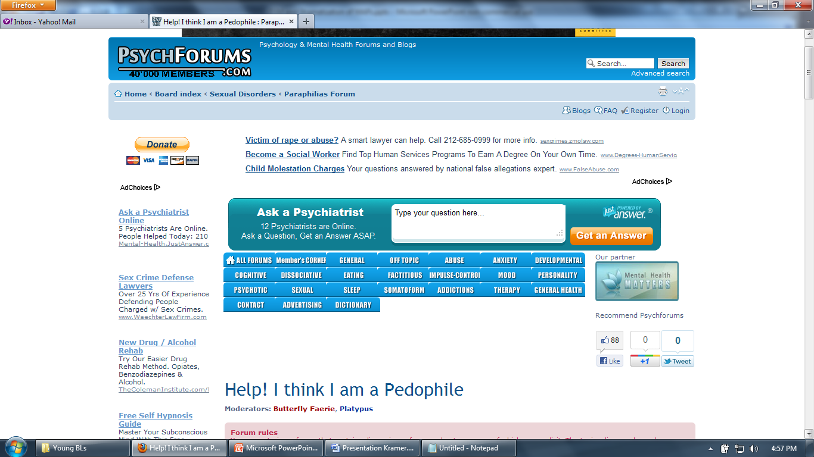
I'm a 15 year old male...I'm not attracted to anyone my age or older anymore. I'm only attracted to pre pubescent girls...i feel like there is no hope for me to live and sometimes I feel like killing myself...I know the idea of a psychologist and everything but I can't talk to anyone at this time because my parents would find out and get the wrong idea and people will judge me and think i really want to hurt little kids...

Slide 14
Stigma and Reluctance to Seek Services
Respondents recognized usefulness of mental health services but were reluctance to seek them
82% agreed: “Sometimes MAPs could benefit from mental health services for reasons related to their attraction.”
Only 30% agreed: “I would seek help from a mental health professional if needed for an issue related to my attraction to minors.”
40% had wanted mental health care for reasons related to attraction to minors, but did not receive it.

Slide 15
Stigma and Reluctance to Seek Services
Percent who believed a therapist would
Not understand their feelings: 85%
  7% uncertain
Would treat them judgmentally: 63%
  26% uncertain
Would not treat them with respect: 54%
  28% uncertain
Would report their feelings to others: 51%
  25% uncertain
Would treat them unethically: 46%
  33% uncertain

Slide 16
Accuracy and Potential
for Stigma in the DSM:
Analysis of DSM-IV-TR and
Proposed DSM-5

Slide 17
Accuracy & stigma in the DSM
Impression that all or most MAPs engage in sexual behavior with children
Not supported by non-forensic research
DSM-IV-TR accompanying text
  list of illegal or manipulative acts
  no description of law-abiding MAPs
  use of the term “pedophilia” to refer to sex offenses
DSM-5 literature review
  only 3 non-forensic studies of MAPs vs. over 30 references to SO and CSA literature

Slide 18
Accuracy & stigma in the DSM
Inaccurate impression of violence or aggression
Contradicted by large amount of non-forensic and even some forensic research
  “majority showed no sign of clinically significant psychopathy or thought disorder. The majority of paedophiles…seem to be gentle and rational.” (Wilson & Cox, 1983)
Misleading statements in accompanying text
  “varying degrees of force,” some cases of Sexual Sadism
  could be said about people attracted to adults

Slide 19
Accuracy & stigma in the DSM
Inaccurate impression: Little resemblance to attraction to adults
Unsupported by non-forensic research
Accompanying text and diagnostic criteria: no mention of non-sexual aspects of attraction
Impression: feelings are alien and incomprehensible

Slide 20
Accuracy & stigma in the DSM
Implicit assumption: MAPs’ motives are always malicious.
Accompanying text implies any caring behavior should be interpreted as malicious in intent.
No consideration of alternative possibilities suggested by non-forensic research
Characterizes MAPs as incapable of caring

Slide 21
Accuracy & stigma in the DSM
DSM-5 literature review may suggest adversarial social control role for the professional
Illegal behavior as sole criteria used for diagnosis
  No discussion of use or reliability of distress criterion
  Only illegal behavior is recommended as future criteria
Takes patient dishonesty for granted
Clinician’s role: diagnose against patient's will?
  Phallometry offense records
Rationale for hebephilia include offense data and strengthen civil commitment

Slide 22
Accuracy & stigma in the DSM
MAPs defined solely as criminals
Possible message to practitioners and MAPs:
Purpose of mental health care is adversarial rather than supportive
Resulting literature: Little guidance for addressing psychological needs of MAPs

Slide 23
Accuracy & stigma in the DSM
Needs identified by 62 MAPs who wanted services but didn't seek them (Summer 2011)
  1. Live in society with this attraction (79%)
  2. Deal with society's negative response (69%)
  3. Improve self-concept (60%)
  4. Deal with sexual frustration (55%)
  5. Understand cause of attraction (45%)
  6. Learn to control sexual feelings (29%)
  7. Develop or increase attraction to adults (24%)
  8. Extinguish or reduce the attraction to boys or girls (23%)
  9. Other (21%)

Slide 24
Accuracy & stigma in the DSM
Needs identified by 62 MAPs who wanted services but didn't seek them (Summer 2011)
  1. Live in society with this attraction (79%)
  2. Deal with society's negative response (69%)
  3. Improve self-concept (60%)
  4. Deal with sexual frustration (55%)
  5. Understand cause of attraction (45%)
  6. Learn to control sexual feelings (29%)
  7. Develop or increase attraction to adults (24%)
  8. Extinguish or reduce the attraction to boys or girls (23%)
  9. Other (21%)

Slide 25
Effects of DSM on Stigma and
MAPs Seeking Services:
Survey Results

Slide 26
Effects of DSM on Stigma
Summer 2011 survey
Respondents reacted to excerpts from
  DSM-IV-TR accompanying text
  DSM-5 literature review
  Non-forensic study (Wilson & Cox)
69-80 respondents

Slide 27
Effects of DSM & Literature on Stigma
Reactions to DSM excerpts
66-89% disagreed with the statements:
  Information like this is accurate.
  The writers want to understand MAPs.
  It encourages a focus on MAPs’ psychological
  well-being.
  I would seek help from a professional who believed information like this.
60-84% agreed with the statements:
  It contributes to adversarial therapist-client relationships.
  It encourages unethical treatment.
  The author accepts the use of phallometry against the patient’s will.

Slide 28
Effects of DSM & Literature on Stigma
Comments
“What would be the point in seeking out a professional likely to traumatize me with these prejudices?”
“has nothing to do with mental health…only identifying illegal activities with the presumption they exist.”
“Isn't the goal of therapy for the person to feel comfortable enough to open up rather than using what amounts to a sexual lie detector?”
“clearly sees pedophiles as the enemy.”
“refers to ‘pedophiles’ as if they were some kind of dangerous animal... quite offensive.”
“[The article] dehumanizes the pedophile. The phallometric test in this instance is unethical and morally reprehensible. The study is meant to prove something, not to help anyone…”

Slide 29
Effects of DSM & Literature on Stigma
Reactions to the Wilson & Cox excerpt
66-74% agreed with the statements:
  The passage is accurate.
  It expresses a desire to understand MAPs.
  It encourages focus on MAPs' psychological well-being.
  I would seek help from a professional who believed information like this.
64-73% disagreed with the statements:
  The passage contributes to adversarial therapist-client relationships.
  The passage contributes to unethical practices.

Slide 30
Effects of DSM & Literature on Stigma
Comments on the Wilson & Cox excerpt
“A positive feature of the text is the way it seeks to remove the 'them versus us' world view.”
“[T]he attitude represented here would be a non-negotiable factor if I ever felt a need for professional help.”

Slide 31
Effects of DSM & Literature on Stigma
One respondent: DSM is “unable to allow both the therapist and the client to work towards a positive outcome.”
If DSM
  portrays MAPs as fundamentally different and dangerous
  recommends only containment and control
Then
  no possible positive outcome of mental health care
  little reason to seek it

Slide 32
Revising the DSM

Slide 33
Revising the DSM
DSM revision should heed APA’s exhortations:
“All recommendations should be guided by research evidence” from “diverse perspectives, disciplines, and areas of expertise.”
  sexology, psychology, evolutionary biology, ethology, etc.
  non-forensic
  free from questionable assumptions and interpretations
The DSM should clearly “reflect the needs of our patients”
  minimize focus on social control
  take into account impact of stigma and life problems MAPs face.
Involve patient groups in revision process
  MAPs have invaluable first-hand knowledge.

Slide 34
Revising the DSM
Changing the conception of MAPs
Patient involvement via in-person meetings

Slide 35
Revising the DSM
Ignoring these guidelines may lead to:
MAPs doubt credibility of DSM and the profession
MAPs avoid mental health services
MAPs remain in hiding
No support for living law-abiding lives
Depression, self-harming, suicide
Unsatisfactory for children, MAPs, and society

Slide 36
Examples of non-forensic research
Hall, G. C. N., Hirschman, R., & Oliver, L. L. (1995). Sexual arousal and arousability to pedophilic stimuli in a community sample of normal men. Behavior Therapy, 26, 681-694.
Howells, K. (1981). Adult sexual interest in children: Considerations relevant to theories of aetiology. In M. Cook & K. Howells (Eds.), Adult Sexual Interest in Children (pp. 55-94). London: Academic Press.
Li, C.K. (1990). Some case studies of adult sexual experiences with children. Journal of Homosexuality, 20 (1-2), 129-144.
Wilson, G. & Cox, D. (1983). The Child-Lovers: A Study of Paedophiles in Society. London: Peter Owen Publishers.

