Slide 1
Forensic Implications of DSM-V’s Pedohebephilia
Renee Sorrentino, MD
Harvard Medical School
Institute for Sexual Wellness
www.instituteforsexualwellness.org

Slide 2
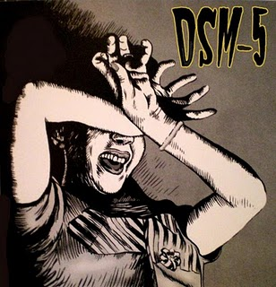

Slide 3
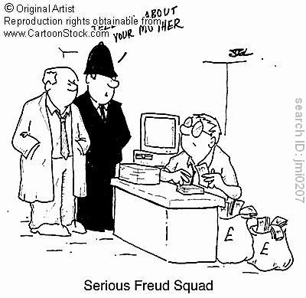
Why am I listening to a Forensic Psychiatrist?
Notes:
.

Slide 4
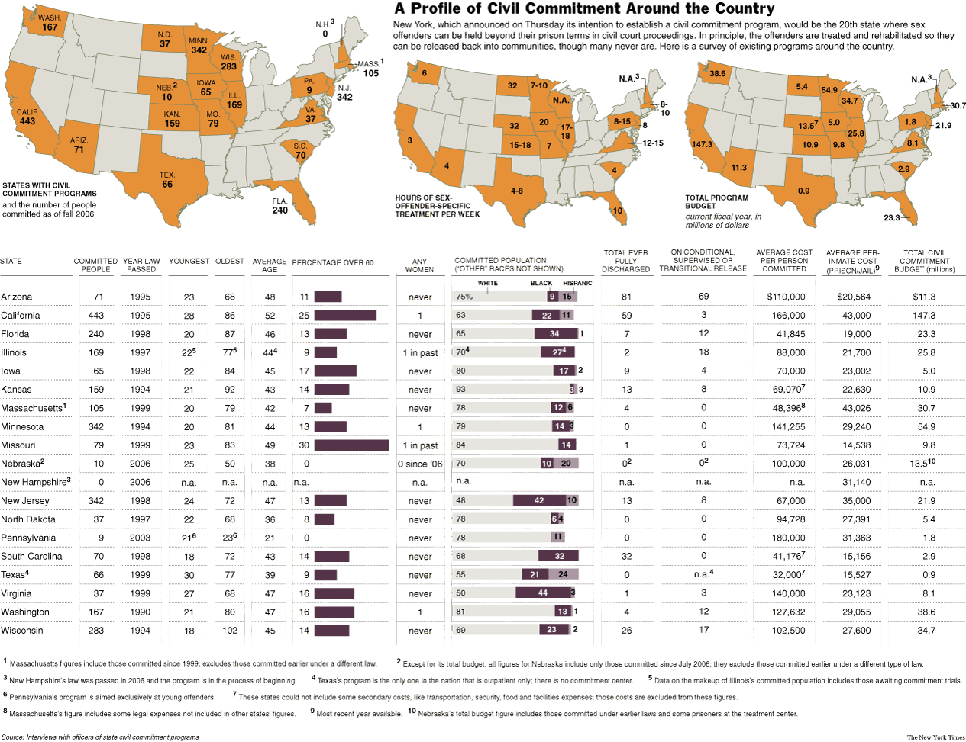

20 States
(2011)

Slide 5
SDP Commitment
  History of sexually harmful conduct
  Mental disorder or “abnormality”
  Risk of future sexually harmful conduct
  Some connection between abnormality and danger

Slide 6



Slide 7
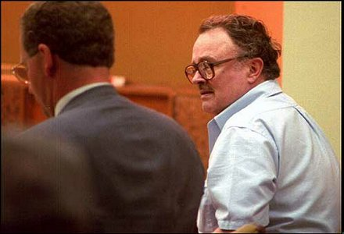
Kansas v. Hendricks, 1997
Leroy Hendricks incarcerated for Child Molestation
Near release said he “could not control his sexual desires for children & will most likely molest again”

Slide 8

Kansas v. Crane, 2002
Michael Crane dx exhibitionist & ASPD
Offense behaviors were willful, not uncontrollable
SDP does not require “irresistible impulse”

Slide 9
Outline
Background
  Role of Forensic Psychiatrist
Forensic Implications of Pedohebephila
  Civil Commitment
    Sexually Dangerous Person
  Criminal Matters
Survey of Psychiatrist
Conclusions

Slide 10
DSM Disclaimer
DSM-IV-TR specifically cautioning against the use of informal labels in the forensic arena:
  [W]hen the presence of a mental disorder is the predicate for a subsequent legal determination (e.g., involuntary civil commitment), the use of an established system of diagnosis enhances the value and reliability of the determination.
  (American Psychiatric Association, 2000, p. xxxiii)

Slide 11

APA Opposes Civil Commitment of Sex Offenders
The task force agreed
  Statutes bend civil commitment to serve essentially non-medical purposes & threaten to undermine the legitimacy of the medical model of commitment
  These statutes have the effect of defining mental illness in terms of criminal behavior.
  This is a misuse of psychiatry, because legislators have “used psychiatric commitment to effect nonmedical societal ends."

Slide 12

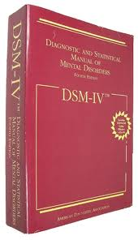
DSM-V

Slide 13
Pedohebephilia Criterion B
One or more of the following signs or symptoms:
  (3) repeated use of, and greater arousal from, pornography depicting prepubescent or pubescent children than from pornography depicting physically mature persons, for a period of six months or longer

Slide 14
DSM-IV-TR
No current diagnosis to address Hebephilia
No diagnosis suggests no disorder
  Paraphilia Not Otherwise Specified (NOS)
If DSM-V proposals accepted
  Pedohebephila is a disorder, disorders cause dysfunction/suffering, warrant treatment, including commitment

Slide 15

Hebephilia=Paraphilia NOS
Manual written for the express purpose of assisting in the civil commitment
The attraction is not pathologic, but the the degree of attraction can be
  Doren, 2002

Slide 16
Looking Forward: DSM-V SDP
Pedohebephilia more likely to be accepted as a disorder eligible for commitment
Commitment “day to life” in the absence of sound scientific disorder
No clear treatment or need for treatment-
  Translates commitment into detainment
  Unable to prove that they are no longer a danger in order to be released

Slide 17

Lessons from the Courts

Slide 18
Hebephilia: SDP
United States v. Carta, 2009
Courts Addressed: Whether Hebephilia, or the sexual attraction to adolescents, qualified as a serious mental disorder that could justify Carta’s civil commitment?

Slide 19
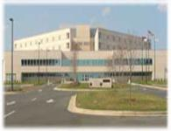
U. S. v. Carta, 2009
Todd Carta, MA
Convicted of Child Pornography
SDP proceedings
Judge ruled hebephilia is not a basis for SDP

Slide 20
U.S. v Carta Ruling
Rejected Hebephilia as eligible for civil commitment
  Absence of any evidence that the DSM-IV-TR residual category of ‘‘Paraphilia NOS’’ was meant to include Hebephilia
  Inherent problems in operationalizing Hebephilia make it an ‘‘unworkable’’ diagnosis
  “Most importantly… limited and scientifically problematic’’ research on the construct, most of it conducted by a single research group

Slide 21
U.S. v. Carta, 2010
Mental DO need not be one so identified in the DSM to meet the statutory requirement
Error to say DSM paraphilia excluded fixation on teenagers accompanied by pattern of conduct such as Carta’s

Slide 22

U.S. v. Shields, 2008
Jeffrey Shields of MA
Convicted of Child Porn, 2002
Found SDP. Appealed
Court held that professional literature may establish hebephilia as a ‘‘group identifier or label,’’ not as a generally accepted clinical diagnosis

Slide 23
U. S. v. Shields, 2011
A "sexually dangerous person" is defined by:
  (1) "has engaged or attempted to engage in sexually violent conduct or child molestation" and
  (2) "is sexually dangerous to others."
  sexually dangerous to others = “the person suffers from a serious mental illness, abnormality, or disorder as a result of which he would have serious difficulty in refraining from sexually violent conduct or child molestation if released.”

Slide 24
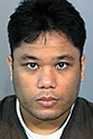
U.S. v. Abregana, 2008
Jay Abregana, Hawaii, convicted of CP & Sexual Assault
Petition filed for SDP
Not Found SDP
Experts disagreed with whether hebephila was “a serious mental disorder”

Slide 25
U.S. v. Abregana Ruling
Conclusion of Law:
  United States has not proven that Abregana "suffers from a serious mental illness, abnormality, or disorder
  Judge opined that ‘‘Paraphilia NOS: Hebephilia’’ might qualify as a clinical diagnosis, but that it did not reach the level of a ‘‘serious mental disorder’’ qualifying Abregana for civil commitment

Slide 26
Hebephilia in SDP Proceedings
Reliance on the dx of Paraphilia NOS/Hebephilia violates due process
  The State must prove the detainee has an actual, valid mental illness or disorder
  Paraphilia NOS (Hebephilia) diagnosis does not satisfy Frye or Daubert standards of admissibility

Slide 27
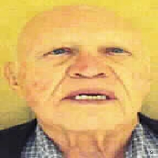
State v. Lamure, 1992
David Lamure, NM
Convicted of Sexual Contact With Minors, Criminal Sexual Penetration
Appealed Convictions
Notes:
Move to the criminal arena

Slide 28
State v. Lamure, 1992
Expert diagnosed Lamure with Hebephilia
Opined Lamure’s claim of a noncoercive relationship with the victim was more consistent with Hebephilia than the victim's claim of a coercive relationship.
Court rejected argument.

Slide 29
Hebephilia: Criminal Arena
State v. Lamure, 1992
  Concept of introducing Hebephilia as a means to excuse criminal conduct
Does this set the stage for arguments against Criminal Responsibility/Insanity? Diminished Capacity?
  Sexual attraction to adolescents is neither a ‘‘sexual perversion’’ nor a legitimate psychiatric condition (Hazelwood & Burgess, 2009;Lanning, 2001)

Slide 30
Paraphilia: Insanity Defense
Mental Disorder
Inability to conform conduct to requirements of the law
Not Guilty by Reason of Insanity
“Paraphilia”

Slide 31

Paraphilias: Forensic Implications
Civil commitment to general psychiatric facility
Eligibility for disability
Custody decisions
Fitness for duty evaluations

Slide 32
Hebephilia: Psychiatric DO
If Hebephilia is sufficient for civil commitment then
  Hebephilia is a mental disorder which impairs function and requires psychiatric treatment
  Hebephilia may, like many mental disorders, cause disabilities
    Impair one’s capacity to parent/custody
    Impair one’s ability to work/fitness for duty

Slide 33
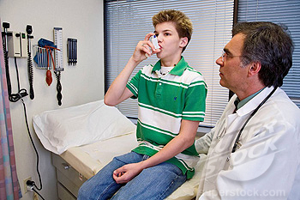
Case : Dr. Pedi
Dx: Pedohebephilia
  Is Dr. P able to perform the functions of his job?
  Is he disabled?
  Is he eligible for disability?
Notes:
.

Slide 34
Expert Consensus
American Academy of Psychiatry and the Law conference, Oct. 2010
  Forensic psychiatrists voted 31:1 against Pedohebephila

Slide 35
Expert Consensus
International Association for the Treatment of Seuxal Offenders, Sept. 2010
  Europeans voted 100: 1 against Pedohebephilia

Slide 36
Conclusions
If Pedohebephilia is accepted in DSM-V, Hebephilia will be used for civil commitment, treated and evaluated for SDP
Allocations of resources which include Hebephilia (v. Pedophilia)
The scientific field will be challenged to answer questions regarding pathology and treatment

Slide 37


